Slide 1
MY FINISHED PROJECTS
ESTO TRIRAMDANI N

Slide 2
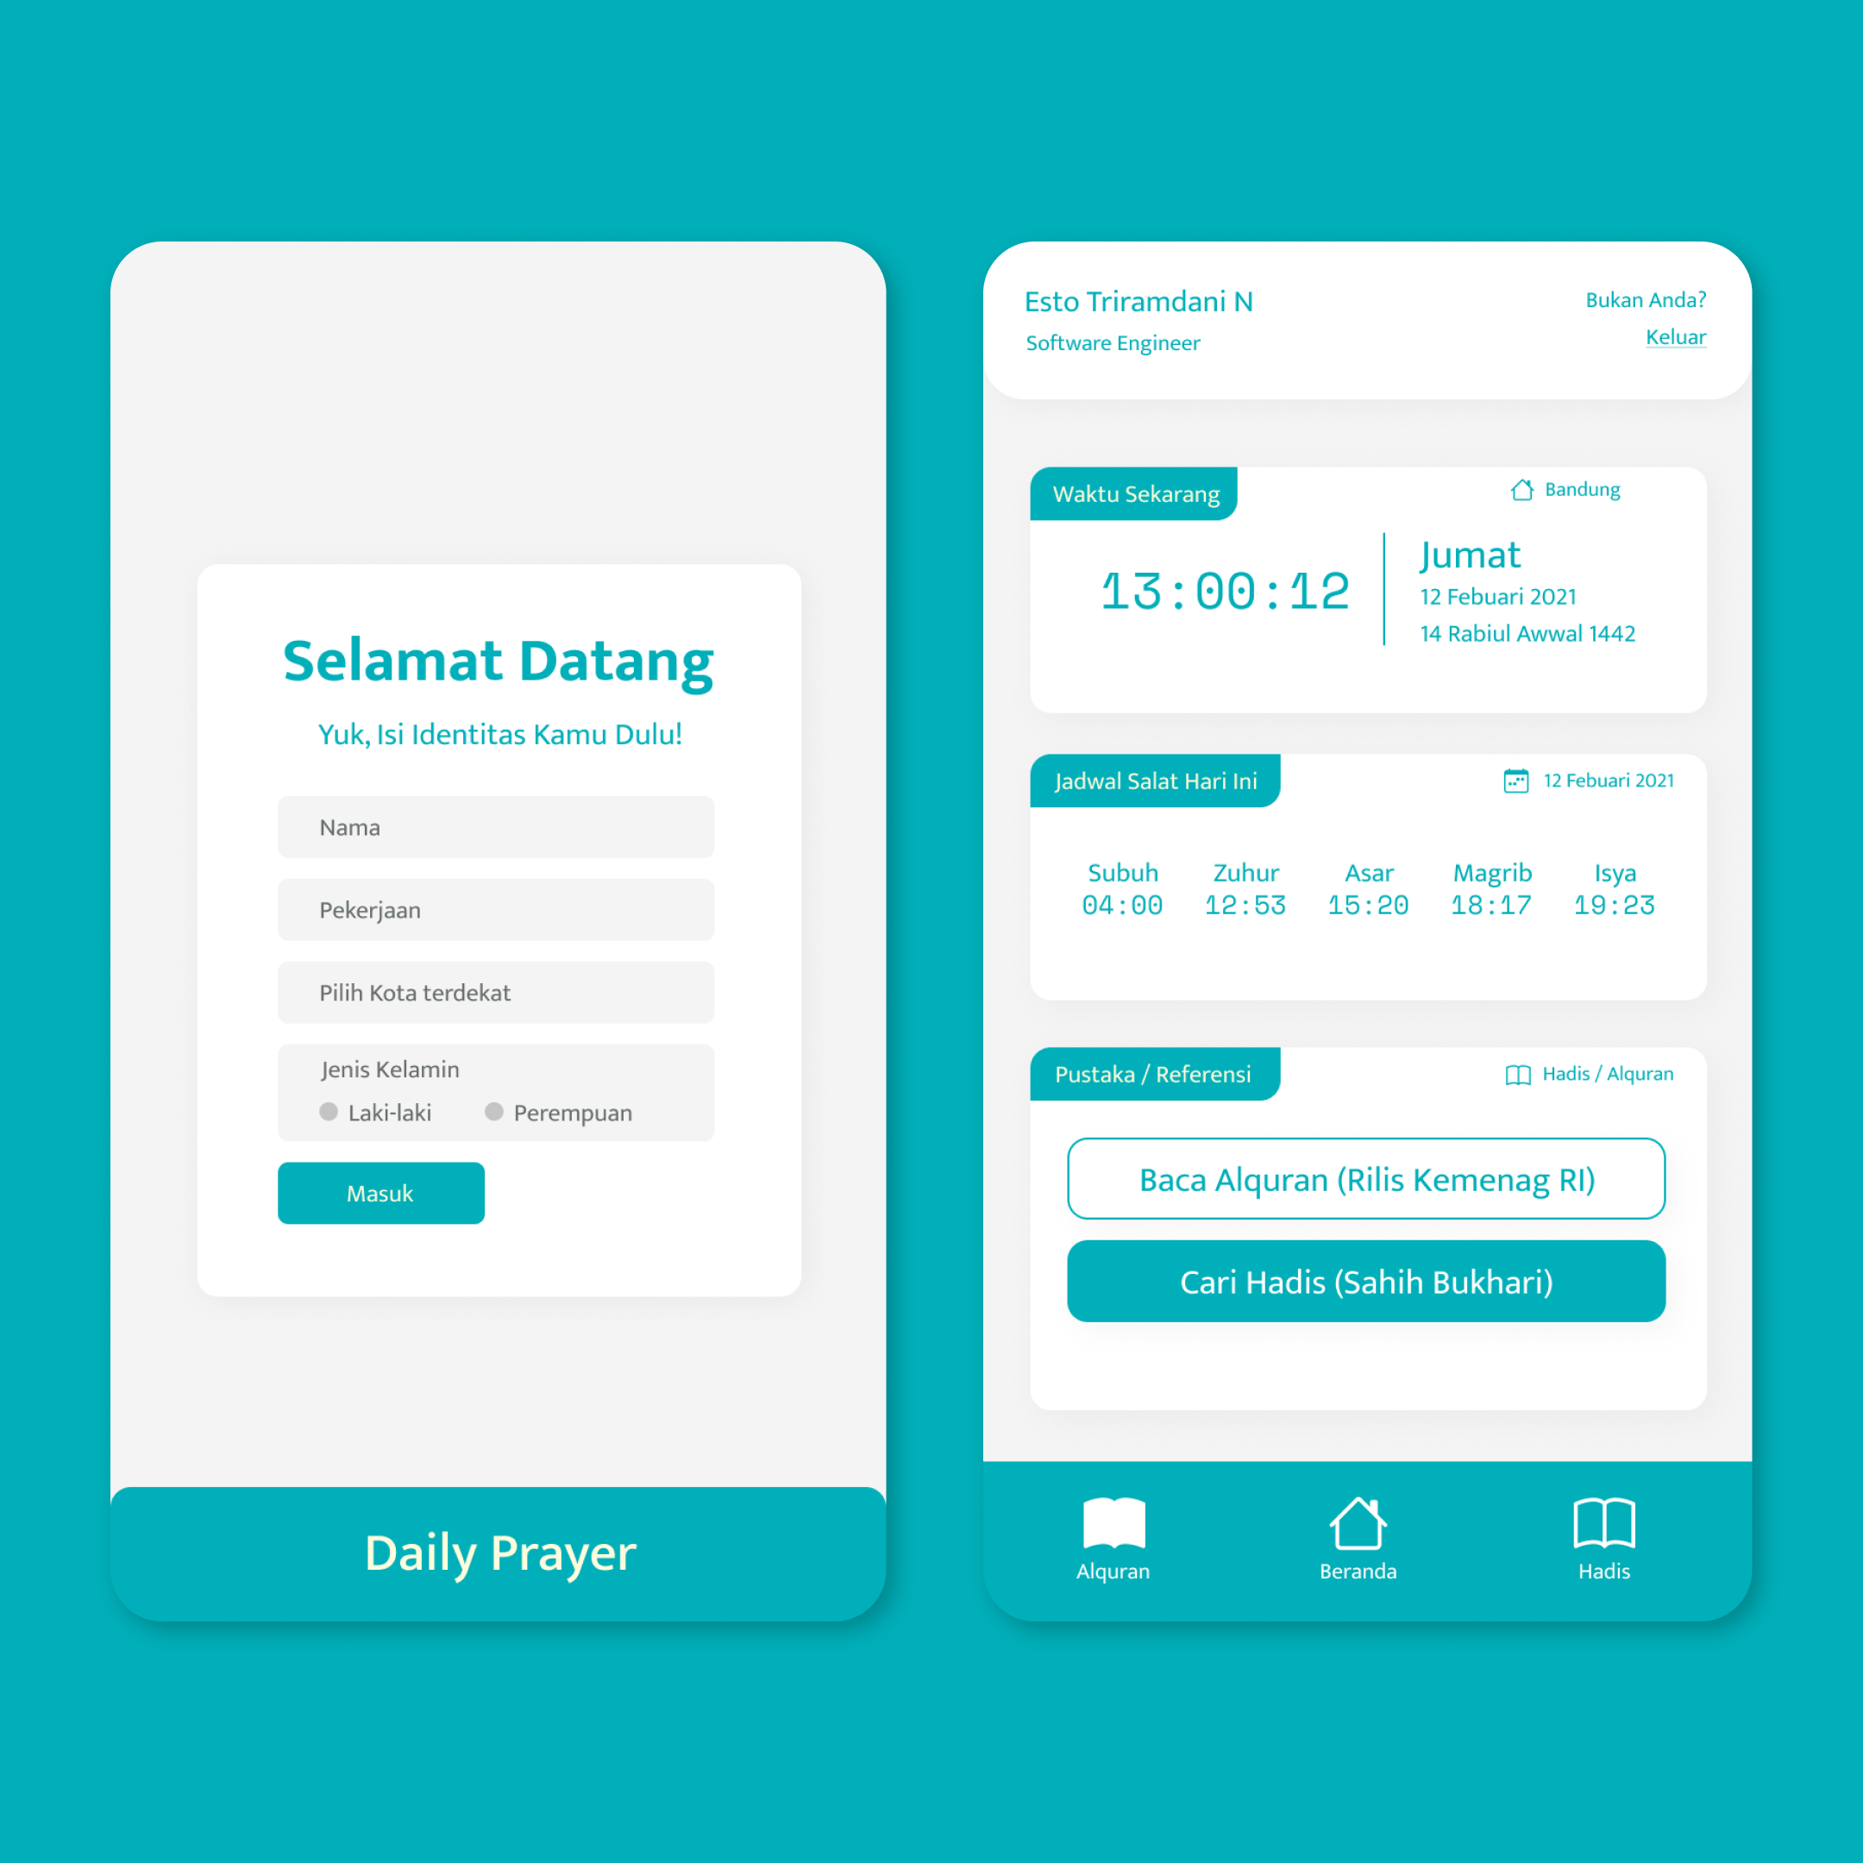
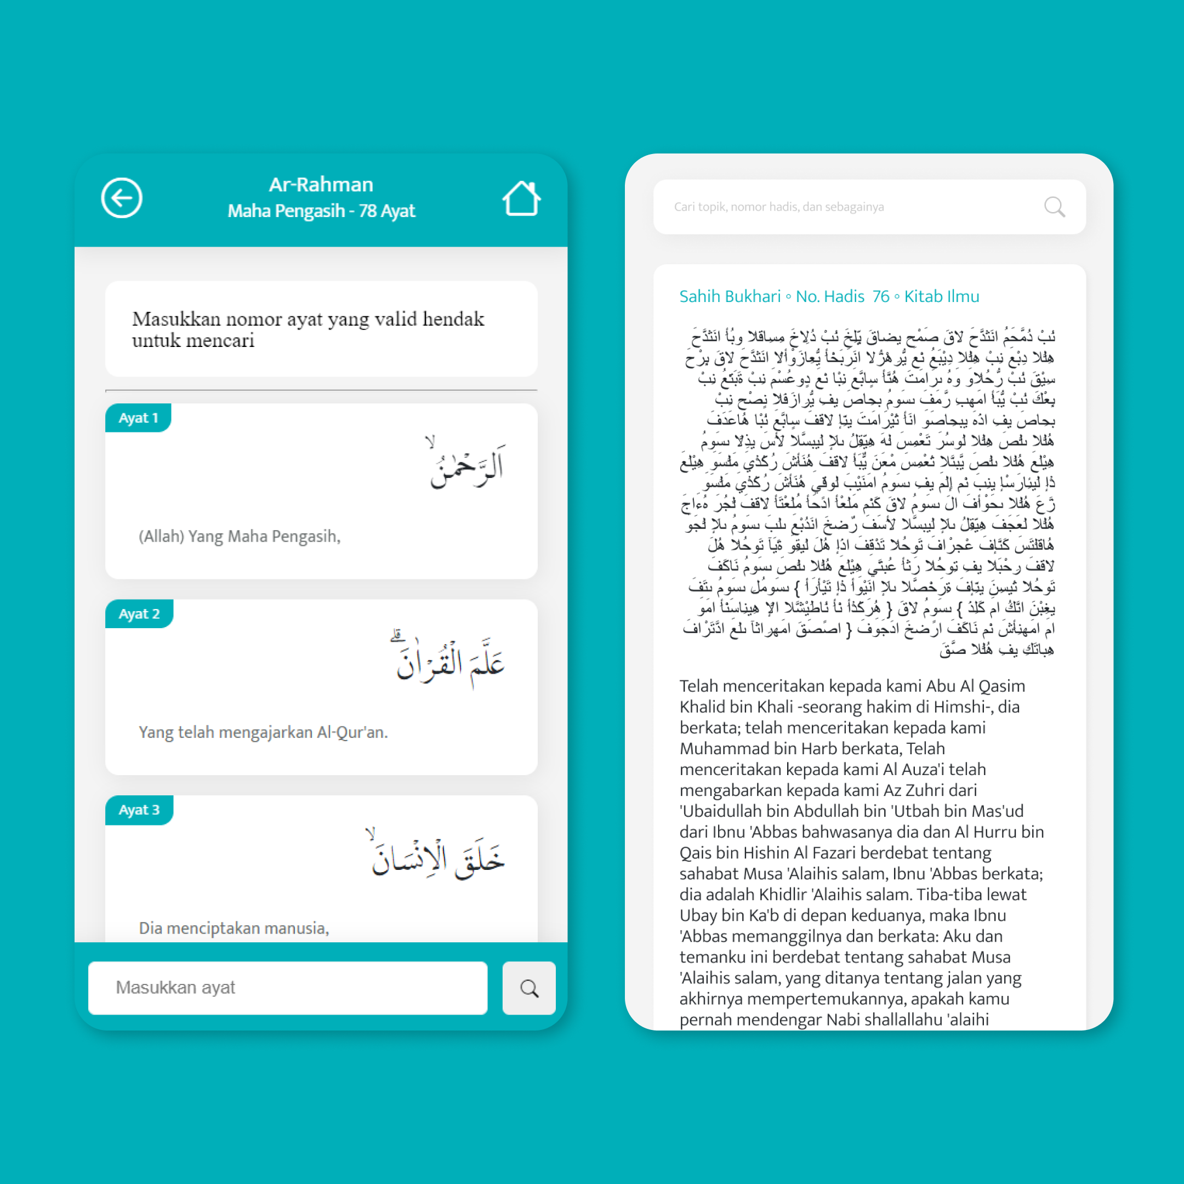
Daily Prayer App
Technology: Figma, React JS, SASS, Progressive Web App Role: UI/UX Designer, Front-end Developer Link to project: daily-prayer-app.herokuapp.com

Slide 3

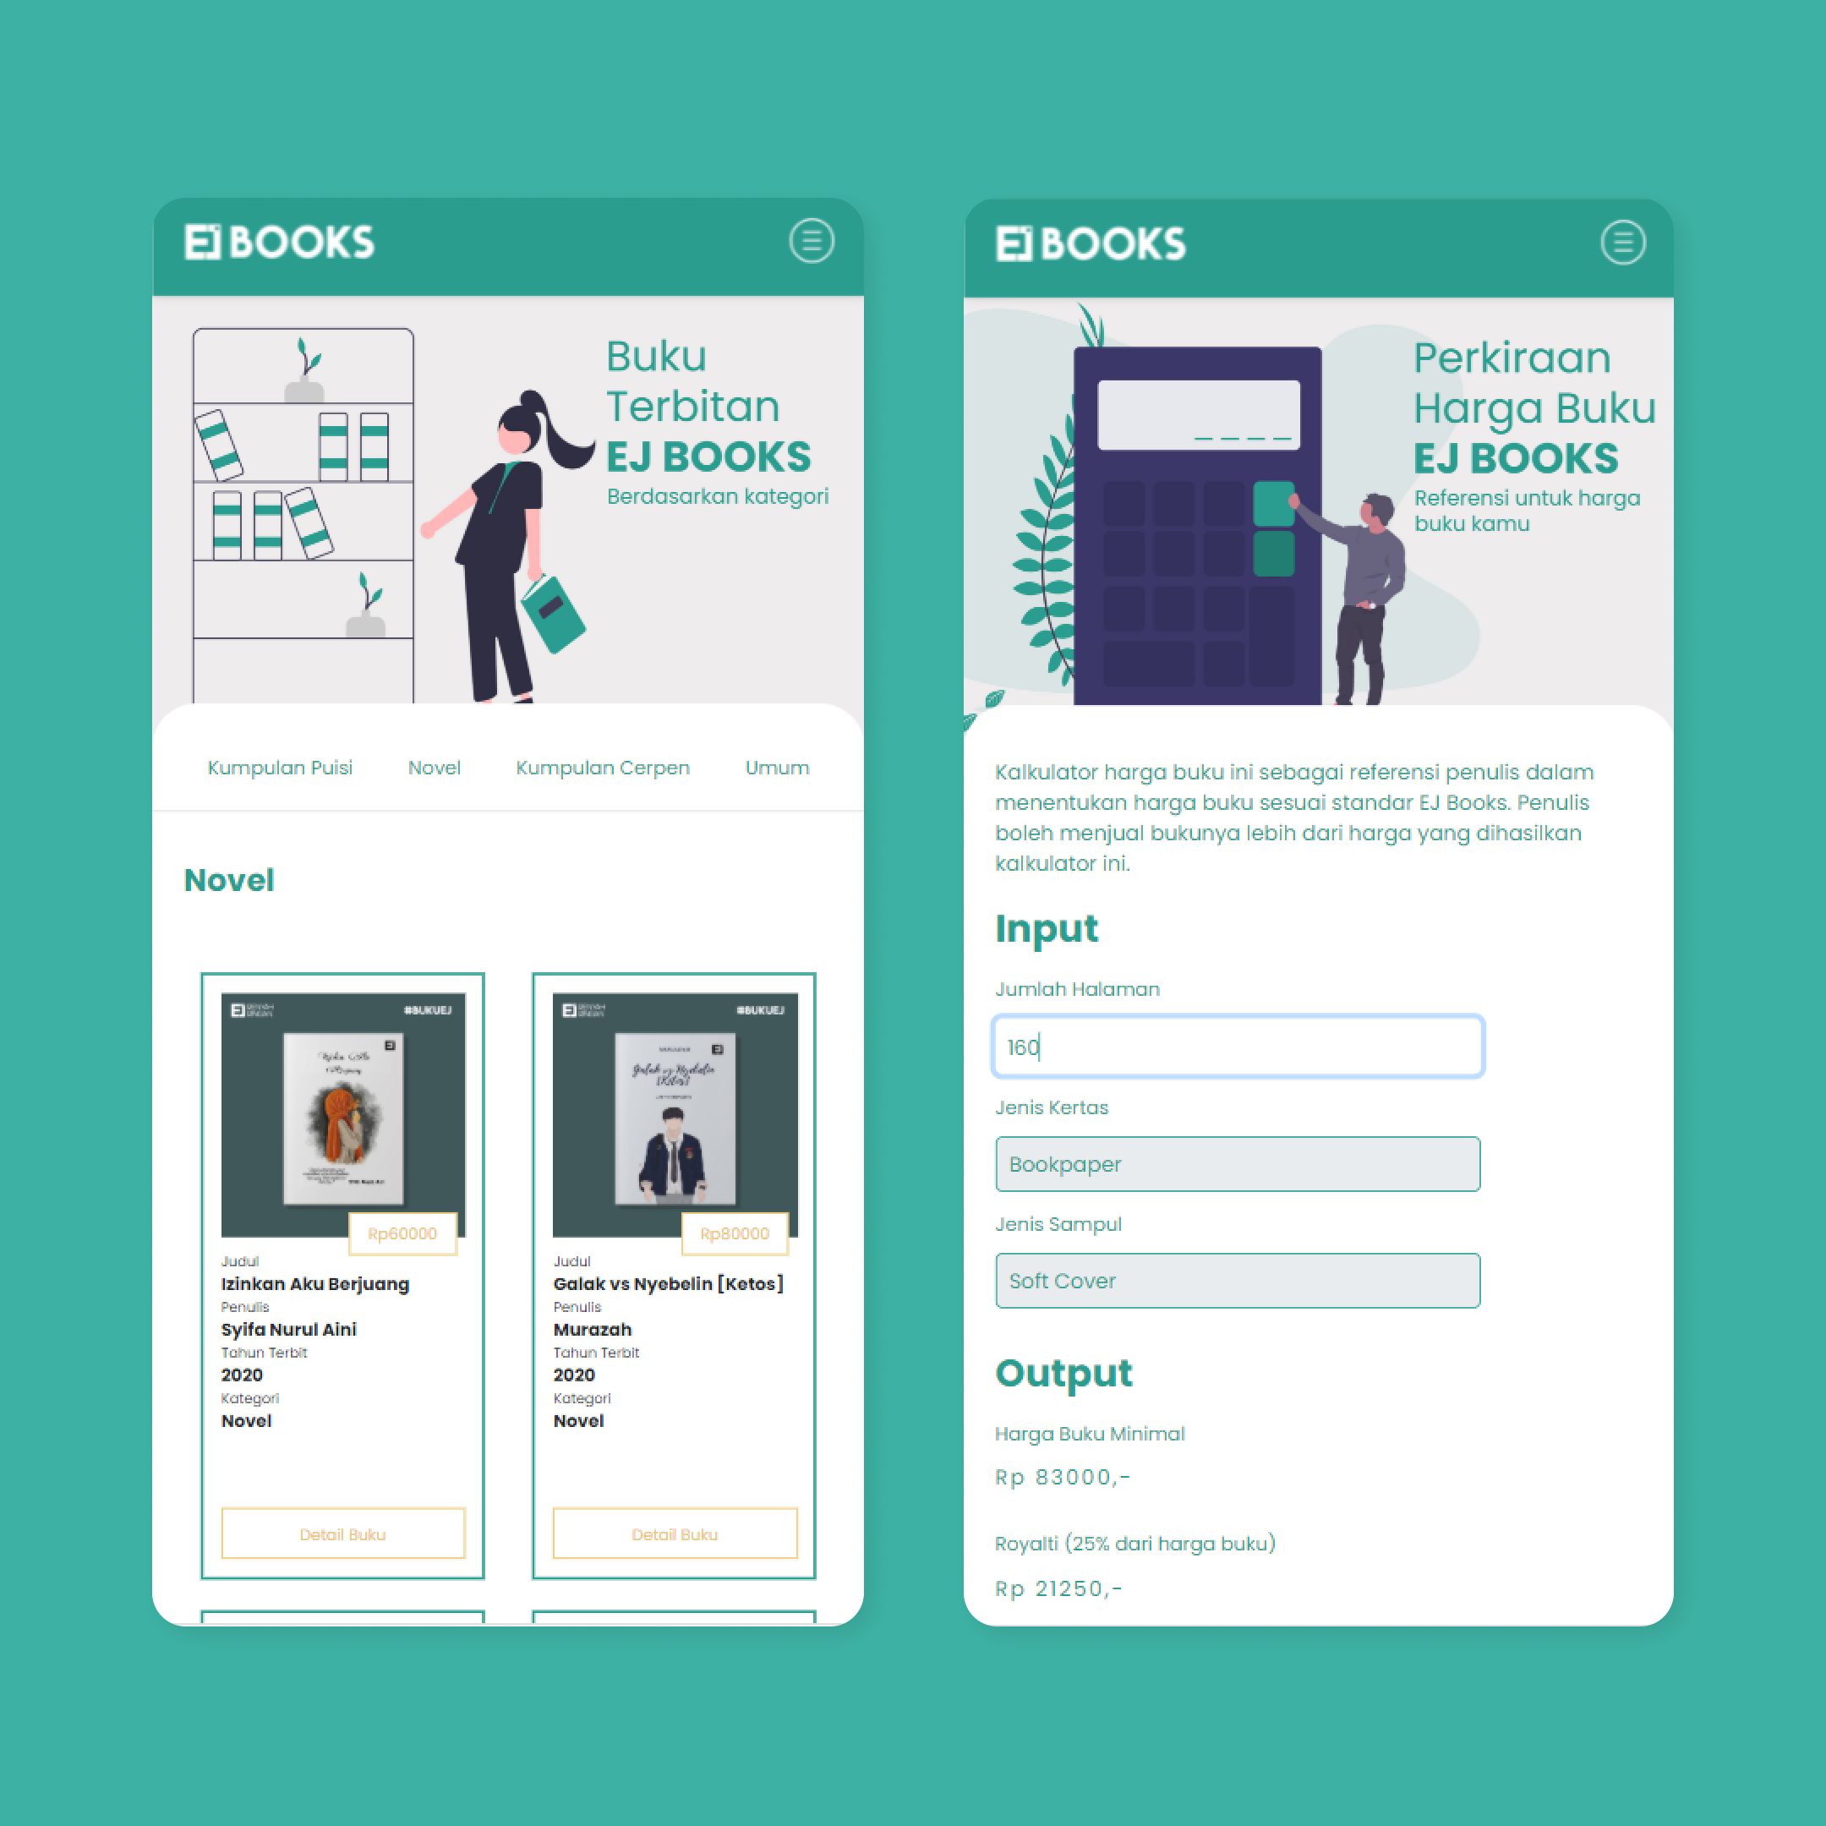
EJ BOOKS Website
Technology: Bootstrap 4.5, SASS, Vanilla JavaScript, Adobe XD Role: UI/UX Desginer, Fullstack Engineer Link to project: penerbit-ejbooks.my.id

Slide 4
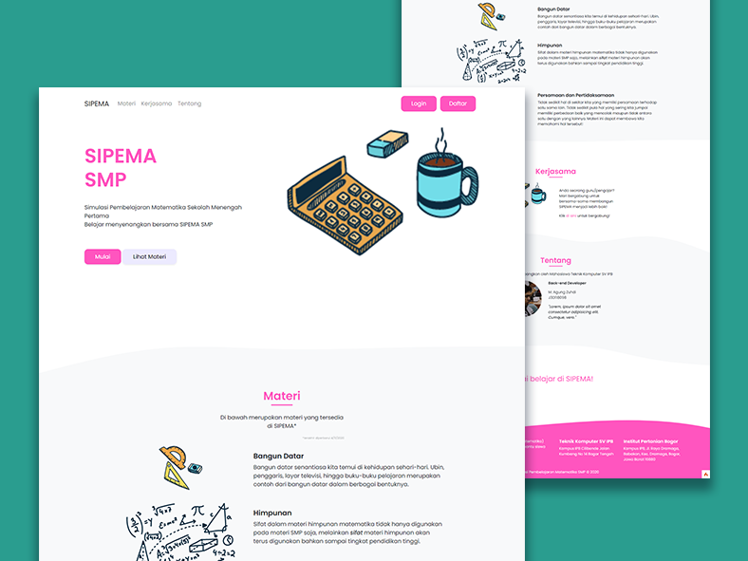
SIPEMA – Sistem Pembelajaran Matematika
Technology:
Adobe XD, Bootstrap 4.5, CodeIgniter 4, OwlCarousel, jQuery Role:
Full-stack Designer Link to project:
https://sipemarpl.000webhostapp.com/

Slide 5
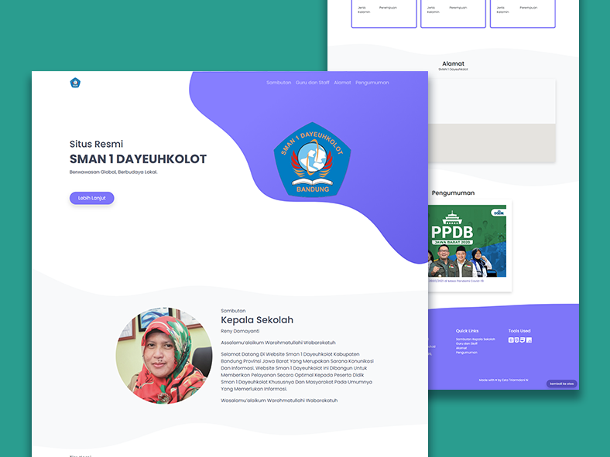
SMAN 1 Dayeuhkolot
A Landing Page
Technology:
Adobe XD, Bootstrap 4.5, Pure CSS, jQuery Role:
Front-end Developer Link to project:
https://smanday-landing.netlify.app/

Slide 6
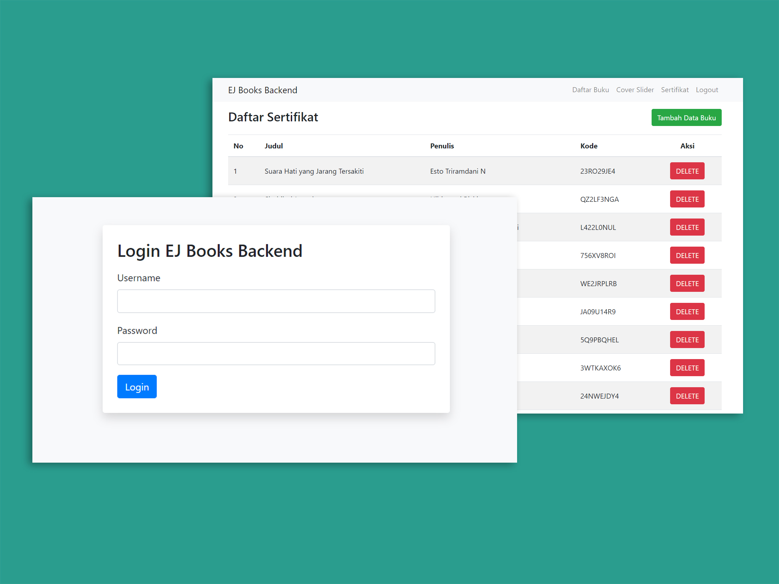
EJ BOOKS Backend
Technology:
Native PHP Role:
Full-stack Engineer Desc:
Serving API to be used in another EJ Books services
Link to project:
http://penerbit-ejbooks.my.id/ejbooks-backend

Slide 7
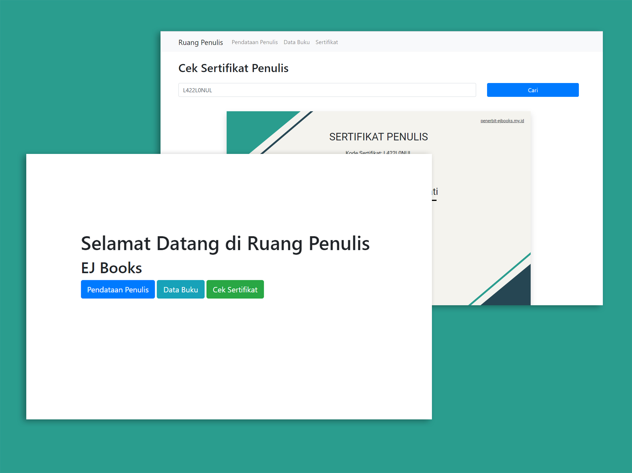
EJ BOOKS Ruang Penulis
Technology:
Native PHP Role:
Full-stack Engineer Desc:
Store writer and books data and create certificate for EJ Books authors automatically
Link to project:
http://penerbit-ejbooks.my.id/ruangpenulis

Slide 8
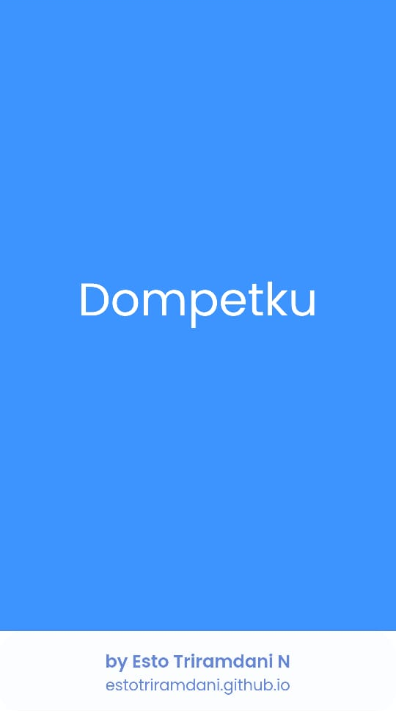
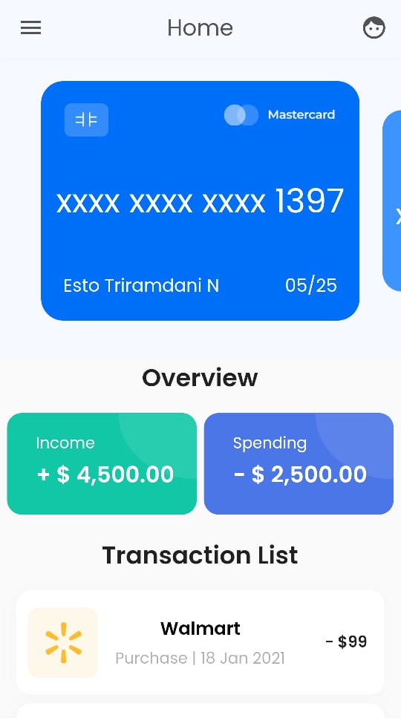
Dompetku
Technology:
Flutter SDK Role:
Mobile Developer Desc:
(Still) static mobile app
Type:
Multiplatform Mobile App
Link to project:
Not deployed to play/app store yet

Slide 9
THANK YOU!
https://estotriramdani.github.io

